Slide 1
File Hash
CALCULATOR
CALCULATOR
CRYPTOGRAPHY AND NETWORK SECURITY
team members
B Pavithra - BU21CSEN0101991
Nikith Kumar K - BU21CSEN0101990
Chaitanyasree D - BU21CSEN0102155
Manish R - BU21CSEN0102079

Slide 2
01
INTRODUCTION
01
About our Project
02
Project
Table of
Encryption, Hashing Algorithm, Block diagram of algorithm
03
Requirements
CONTENTS
Hardware and Software
04
Pros And Cons
About the algorithm used in the project
05
Outcomes
Working prototype, Future works

Slide 3

Introduction
A Python-based tool designed to ensure the integrity and confidentiality of your digital files.
This project combines the robust SHA-256 hashing algorithm with AES encryption to provide comprehensive protection for your sensitive data.

Slide 4
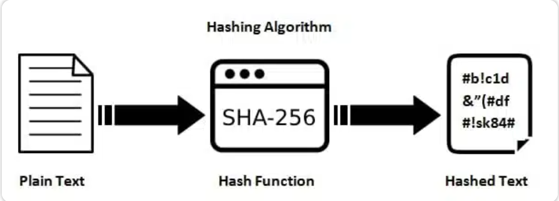
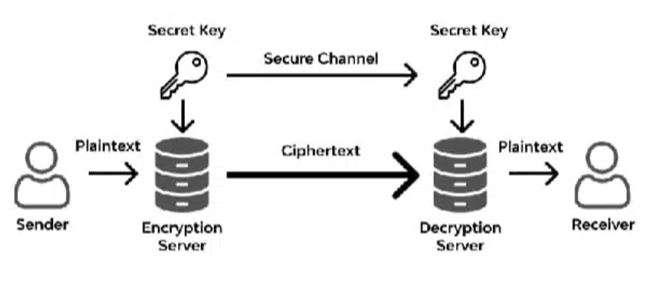
PROJECT
SHA-256
SHA-256, which stands for Secure Hash Algorithm 256-bit, is a cryptographic hash function that generates a 256-bit (32-byte) hash value from input data. It is part of the SHA-2 family of hashing algorithms developed by the National Security Agency (NSA) and published by the National Institute of Standards and Technology (NIST) in 2001.
AES
AES, or Advanced Encryption Standard, is a symmetric encryption algorithm widely used to secure sensitive data. It was established as the successor to the Data Encryption Standard (DES) by the National Institute of Standards and Technology (NIST) in 2001.

Slide 5







BLOCK DIAGRAM
HASH FUNCTION
AES ENCRYPTION
AES DECRYPTION
FILE (M)
E(K,[M])||H(M)
HASH FUNCTION
HASH FUNCTION
COMPARE

Slide 6






Requirements
Basic requirements need to run this project
Hardware Requirements:
Server/Computer: Standard specifications sufficient.
Client: Any device with a modern web browser.
Software Requirements:
Operating System: Windows, macOS, Linux
Python 3.x
Flask (Web Framework)
Cryptography (Fernet)
Hashlib, Werkzeug, ... (other used libraries)

Slide 7
PROS AN D CONS
SHA-256
SHA-256
Possibility of Hash Collision
Deterministic Hashing
Theoretical Weakness in Pre-Image Attacks
Data Integrity Assurance
High Level of Security
Computational Efficiency
AES
AES
Robust Security Implementation
Strong Key Sizes
Wide Adoption
High Level of Difficulty for Hacking
Uniform Encryption
Software Implementation Complexity
Key Management
Algorithmic Aging

Slide 8
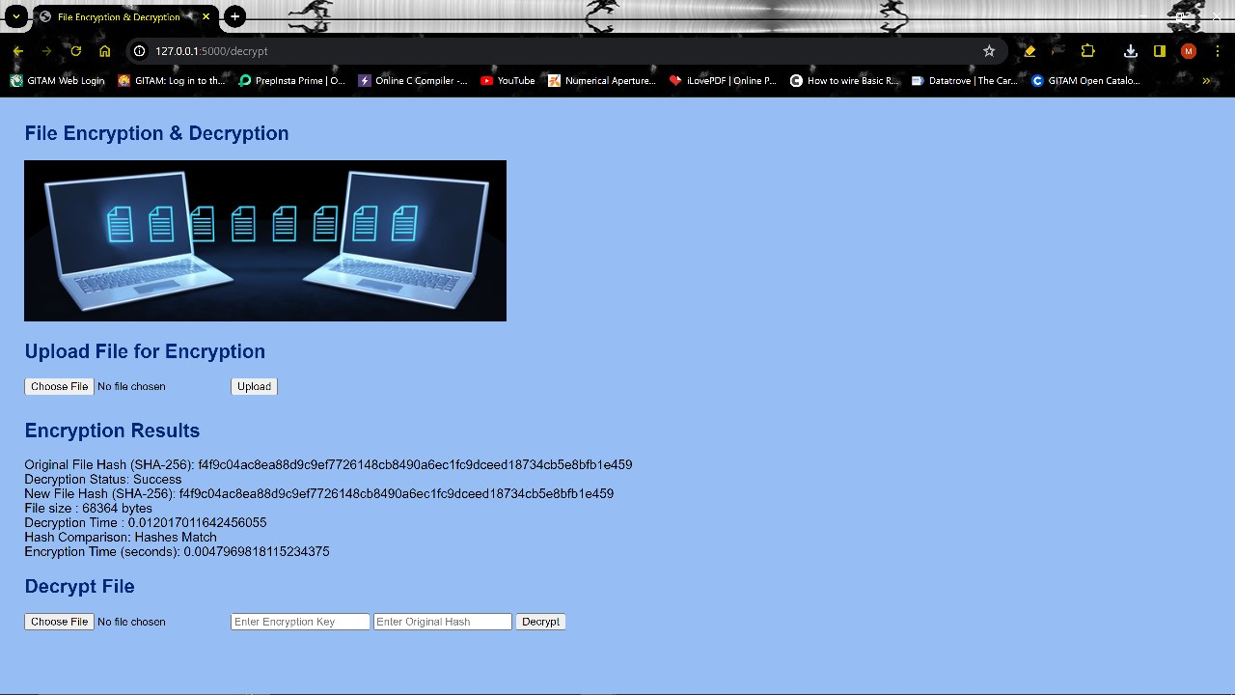
Outcome of
PROJECT

Slide 9
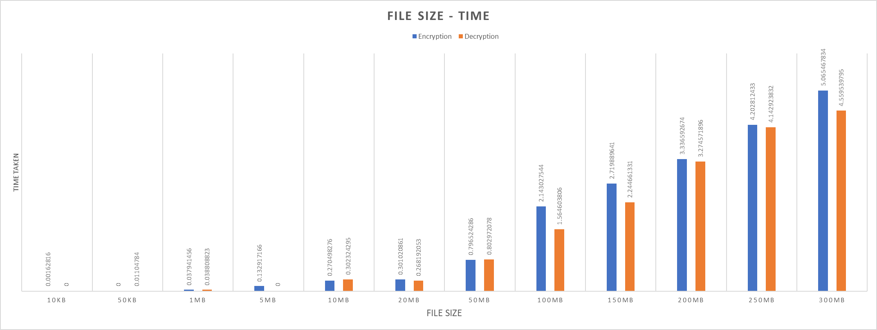
GRAPH
FILE SIZE VS TIME TAKEN

Slide 10


